Slide 1
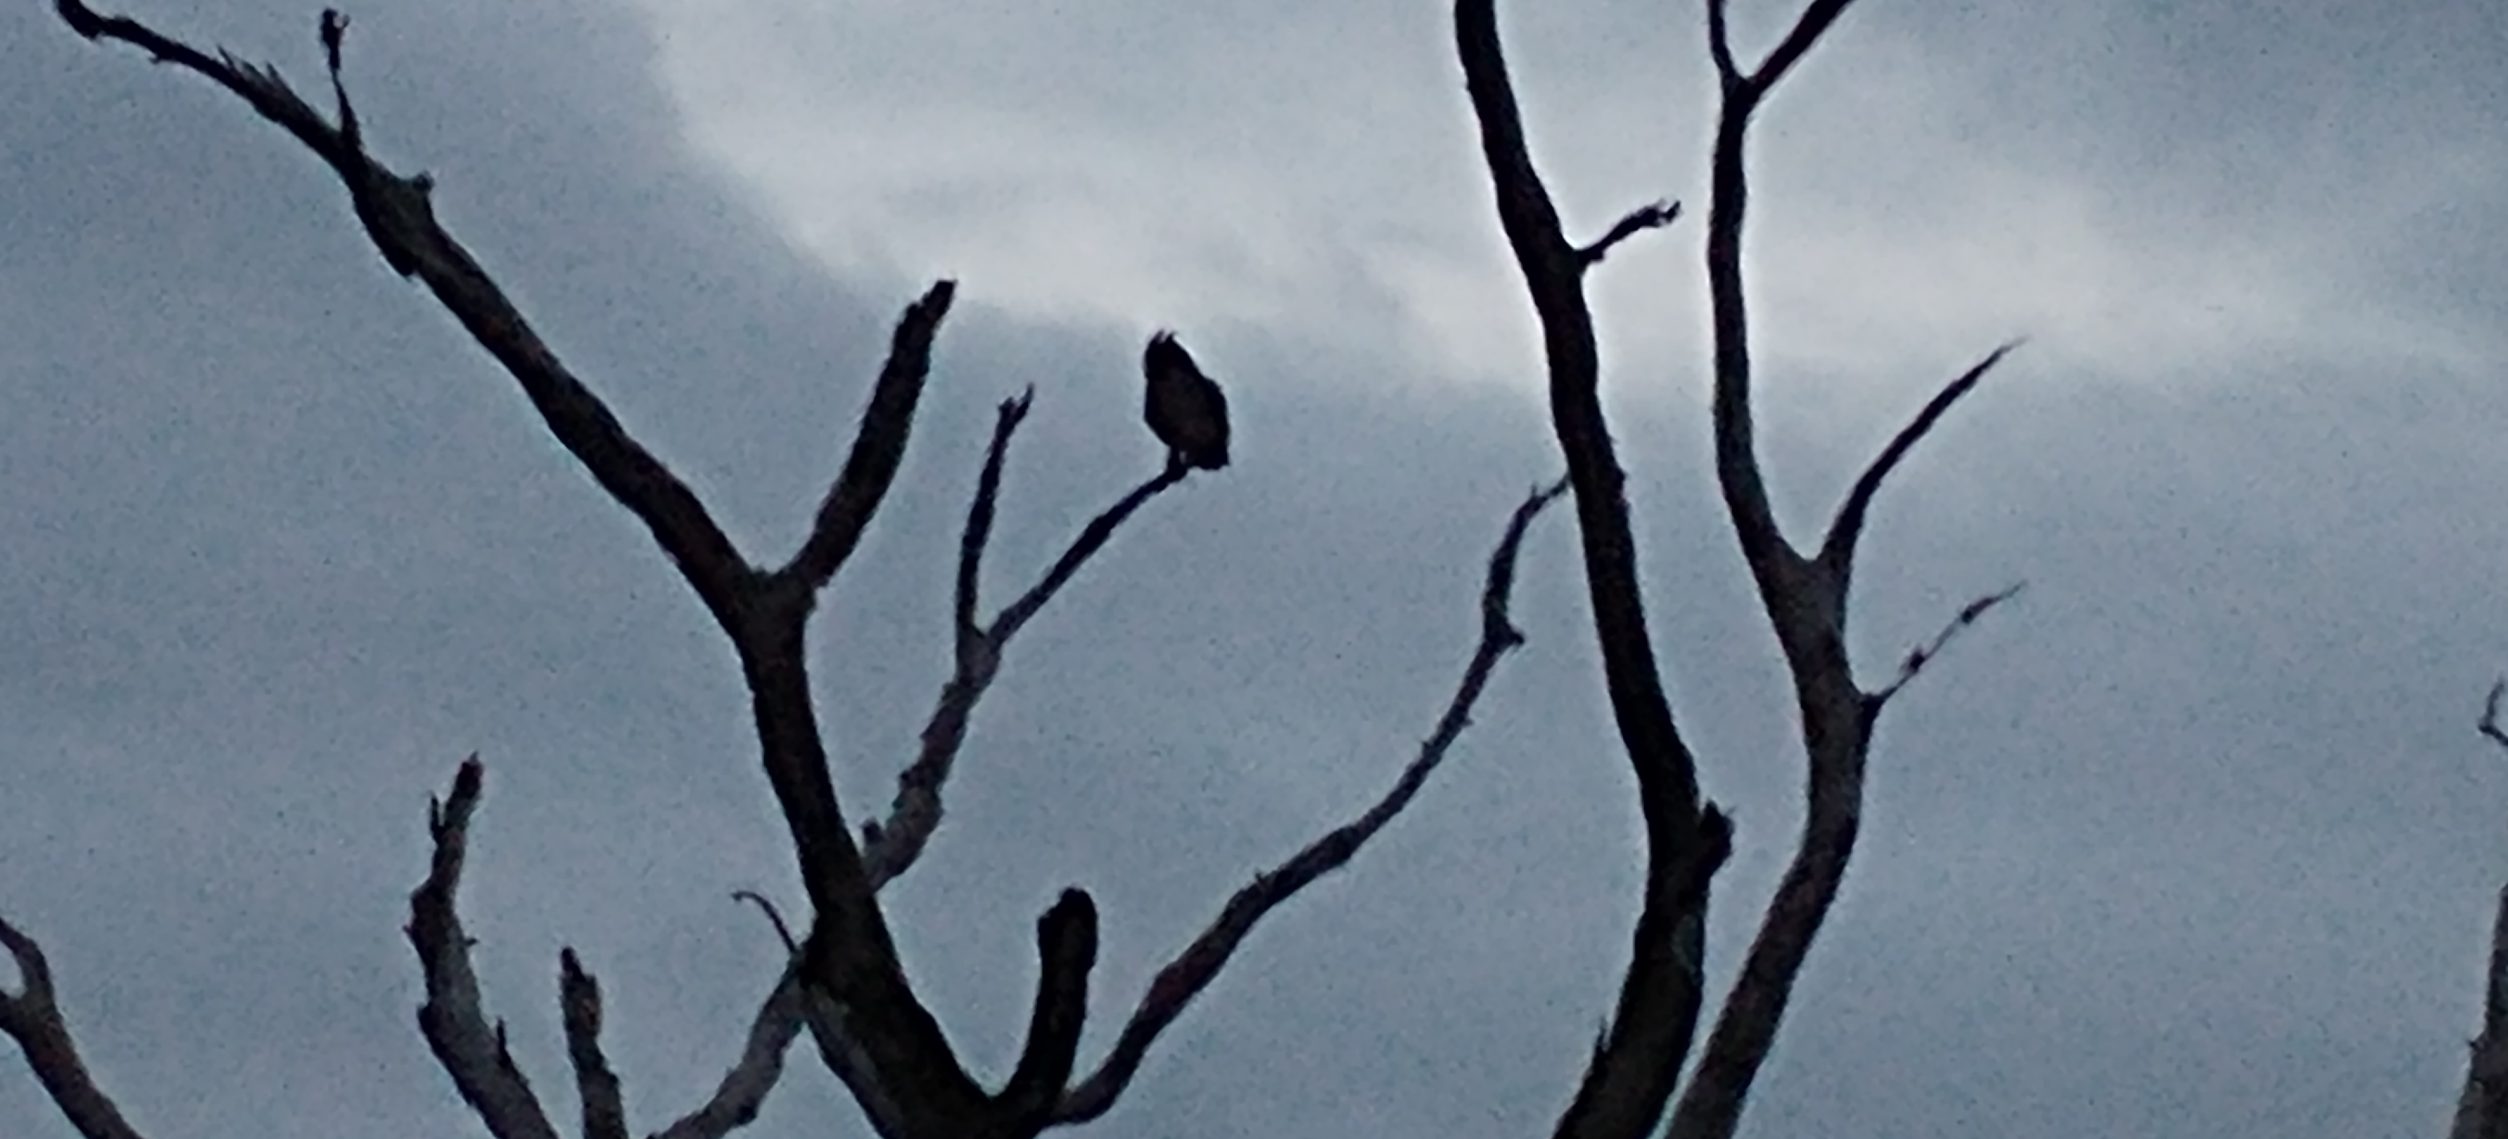
Writing Fresh Environmental Stories

Slide 2
Creative Alignment
Why – Who –What?
What do you know well? Have experience with? Are obsessed by? Balance with challenges and anxieties (overcoming obstacles always a good story)
What is a story only you can tell?
What’s an urgent story to tell? (if we don’t act, x)
What’s a story you could research forever and ever?

Slide 3
Cultural Narratives
Self
Universal but in the particular
Push back against cultural narratives—X is supposed to be, but my experience is Y
Self
Society

Slide 4
Alan Gurganus
“We’re all fools for beauty. Apart from the joy of being in love, the pleasures of community, the delight of living around children and the right to eat three times daily — it’s the biggest privilege. Despite our constantly poisoning this planet, who can deny it’s stayed stubbornly beautiful. Fiction begins with the little we can agree upon. Natural beauty offers such a starting place.”
Add something funny and something beautiful on every page? Readers will likely stay longer. (The trick, of course, is deciding what in the world you find most amusing and gorgeous).

Slide 5
Rachel Carson (loss)
THERE WAS ONCE a town in the heart of America where all life seemed to live in harmony with its surroundings. The town lay in the midst of a checkerboard of prosperous farms, with fields of grain and hillsides of orchards where, in spring, white clouds of bloom drifted above the green fields. In autumn, oak and maple and birch set up a blaze of color that flamed and flickered across a backdrop of pines. Then foxes barked in the hills and deer silently crossed the fields, half hidden in the mists of the fall mornings . . . Then a strange blight

Slide 6
Loved / Loss
Make a column of places you’ve loved / those lost (could work for people too)
Think about the first time you visited. The last time. What’s Changed?

Slide 7
Keep it Fresh
What perspectives are you tired of? Seem worn? Where are the voids or gaps in the conversation? How could you find out more (interview or talk with) to give writing vitality?
Climate—polar bears, house falling into ocean. Rural? Class?
Unlikley or accidental environmentalist? A reluctant one?
Don’t “do” nature?

Slide 8
Class Anxiety
essay
Bird Watching
Dumpster Diving

Slide 9
Climate Anxiety
essay
Project

Slide 10
Spoonful of Sugar
Trojan horse.
Start in scene – walking across a field, eating a berry just picked, dog . . .
“The best arguments in the world won’t change a person’s mind. The only thing that can do that is a good story” -- Richard Powers, The Overstory

Slide 11
Arc of Discovery
I used to think . . .
Now I think . . .
It might also be true that . . .

Slide 12
Honor Complexity
Avoid the overly hopeful ending and the catalog of despair.
Readers distrust both pure optimism and pessimism.
Righteous anger and moral certitude falls flat on the page.
Instead? Journey. Discovery. Story. Humor?
“Hope is an embrace of the unknown and the unknowable, an alternative to the certainty of both optimists and pessimists. Optimists think it will all be fine without our involvement; pessimists adopt the opposite position; both excuse themselves from acting.” -Rebecca Solnit

Slide 13
Unlikely Heroes
Flawed personae / characters
Get off high horse / no trumpets. At close, maybe tiptoe back to that initial story, indicate what it means, reflect on it. Not “it’s high time that we . . . .” Not polemical . . . no call to arms . .
How to manage terrors?
“Even a wounded world holds us, giving us moments of wonder and joy. I choose joy over despair, “Not because I have my head in the sand, but because joy is what the earth gives me daily and I must return the gift”-Robin Wall Kimmerer, Braiding Sweetgrass
“Not everything is decaying faster than we can love it.” –Lauren Groff, Florida

Slide 14
If Op-Ed . . .
1) Hook. Scene with sensory details. Walking in fields, having conversation. Something at stake.Maybe a little twist toward policy.
2) Build case. Marry emotional of beginning with rational and logical. Scene if you can. Specific animals on road rather than numbers (but policy on numbers).
3) The other side. I’ve done the work, come out the other side.
4) Rachel Carson cost. If this chemicals continue, this is what happens. Behavior change or outcome. Make a request.

Slide 15
Lessons from the Slush Pile (Megan Mayhew Bergman)
“Like Thoreau, I…” → Complicate the narrative
Climate change makes me sad → Ground the work in specificity and make it new.
Now I will tell the “sad” story of indigenous or impoverished people whom I visited once on vacation → Really think about whose stories you tell, what POV you use, and who you pity (have you allowed for joy? Do you really understand or have insight?)
Manifesto X → When was the last time you enjoyed reading a manifesto?
Fantasy with magical solutions to problems → Readers see contrivances easily. Dig into character, make believable rules and allow the reader to trust you.
Good Guys vs Bad Guys → Life and people are rarely tidy. Environmentalists, even fictional ones, are not perfect, and still have motivations and flaws.
Fiction with an agenda → Story first. Readers have to want to keep reading. Don’t let them see you work. Trust organic symbolism.
Notes:
Give bio. Meet challenges with technical suggestions.

Slide 16
Also Watch For
The overly sentimental and nostalgic (how good was it?)
Oneness
Romanticizing the primitive

Slide 17
Cli-Fi
From Guernica’s special climate issue, Amy Brady:
...we distance ourselves because the facts of global warming are too often presented in abstract or guilt-inducing ways. In order for us to get it—to actually face it—we need vibrant narratives that help us feel an emotional connection to what we’re losing...
These stories exemplify the genre of “climate fiction,” or “cli-fi,” by exploring what the world might become if climate change continues unabated. Its roots are in science fiction, but here, it’s tinged, beautifully so, with realism and the supernatural. At its best, cli-fi conjures, spell-like, meditative spaces in which we ponder our deepest fears before emerging transfigured.

Slide 18
Fresh
Human as animal
Diversity of Protagonists
Push Back Human Exceptionalism
Hybrid Genres (memoir, lyric essay)
Old stories in new climate environments (Children’s Bible)
Digital and soundscapes
Science crossing over into story (Kimmerer)

Slide 19
Ways to Go Deeper
More research
Quote from reading
A story next to your story
Crank up the metaphor
More scene and dialogue.

Slide 20
Try a Beginning . . .

